Slide 1
Flight Price Prediction
Project
Submitted by:-
Shubham Nalawade

Slide 2
-:PROBLEM STATEMENT & UNDERSTANDING:-
Flight ticket prices can be something hard to guess, today we might see a price, check out the price of the same flight tomorrow, and it will be a different story.
To solve this problem, we have Scrapped with prices of flight tickets for various airlines between the months of January and march of 2022 and between various cities, using which we aim to build a model which predicts the prices of the flights using various input features.

Slide 3
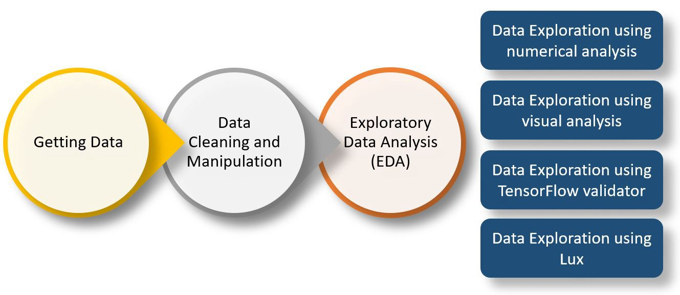
-:EDA STEPS & VISUALIZATION:-
Checked the shape of dataframe
Checked the data types
Checked Null Values inside dataframe
Visualization of the data

Slide 4
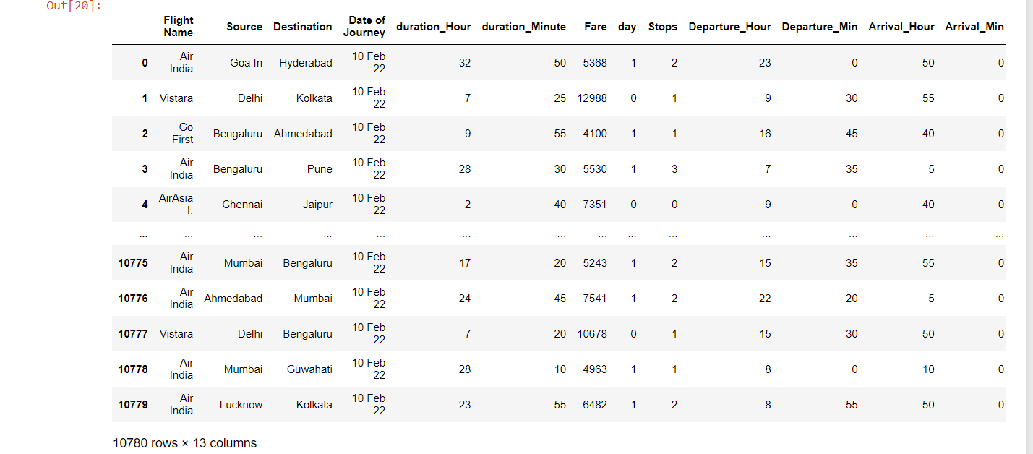
-:The Data:-

Slide 5
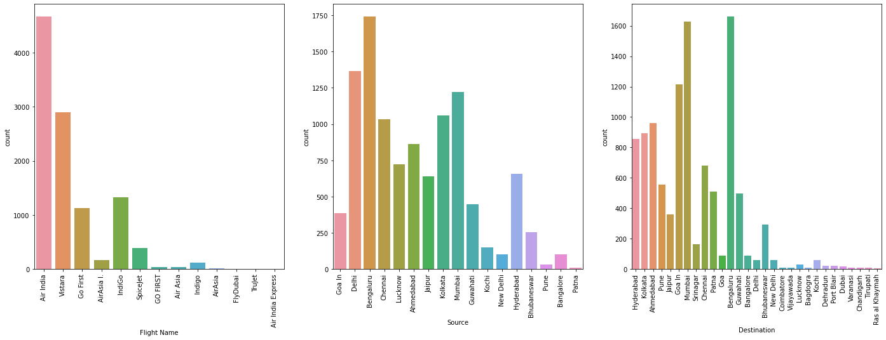
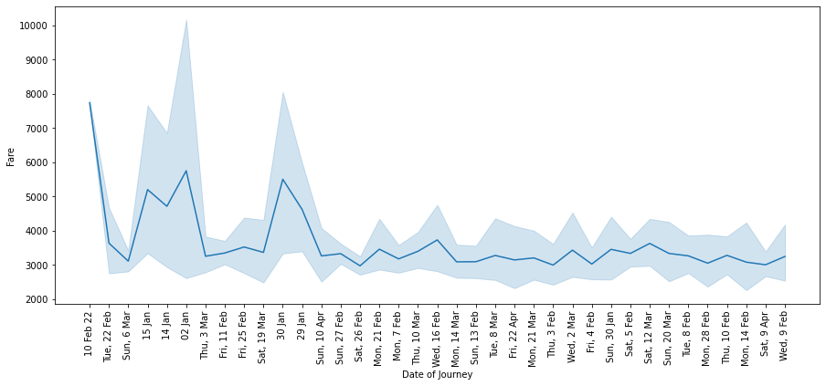

Slide 6
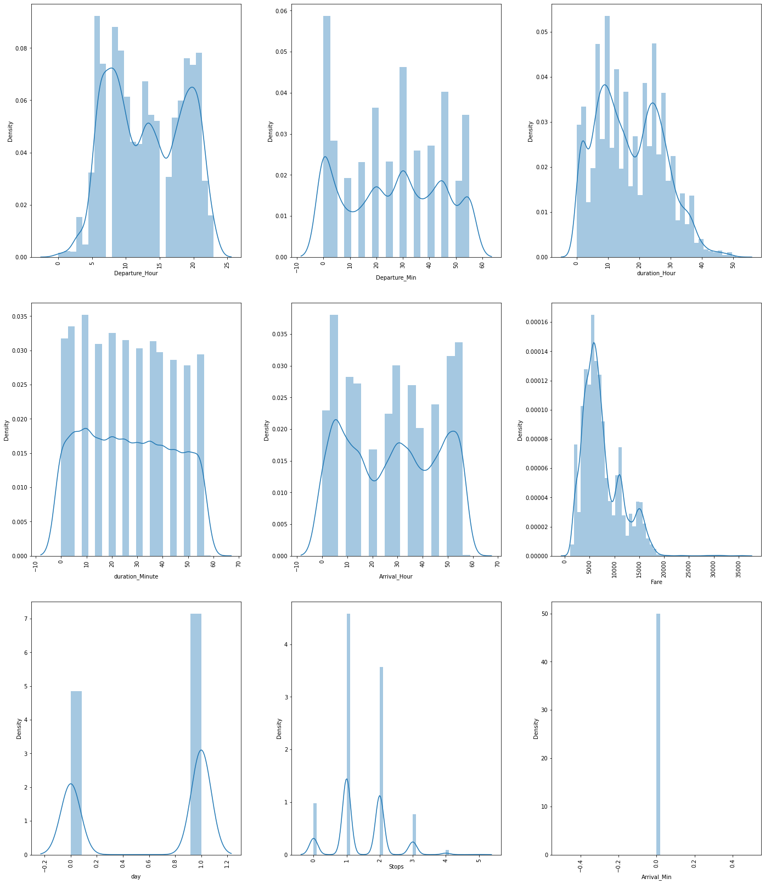

Slide 7
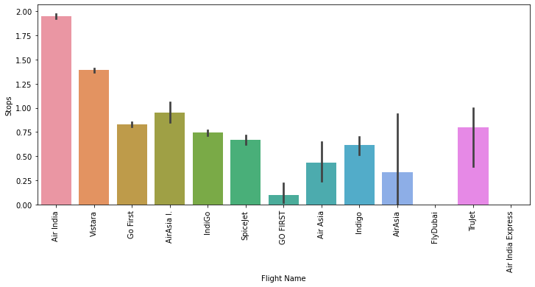
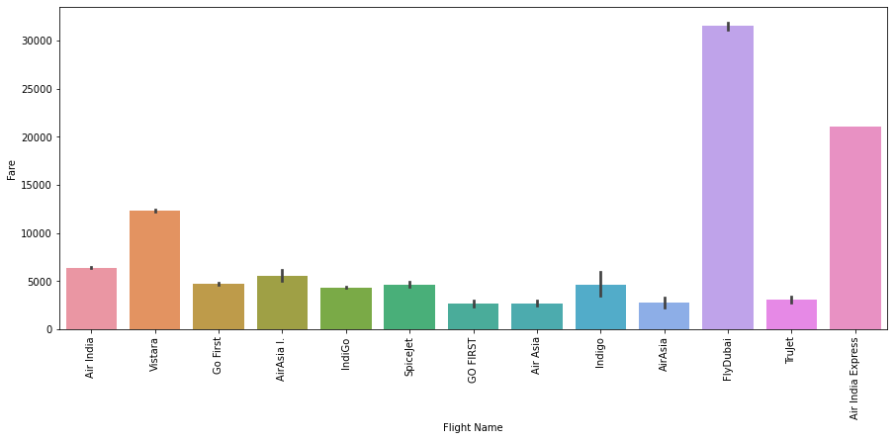

Slide 8
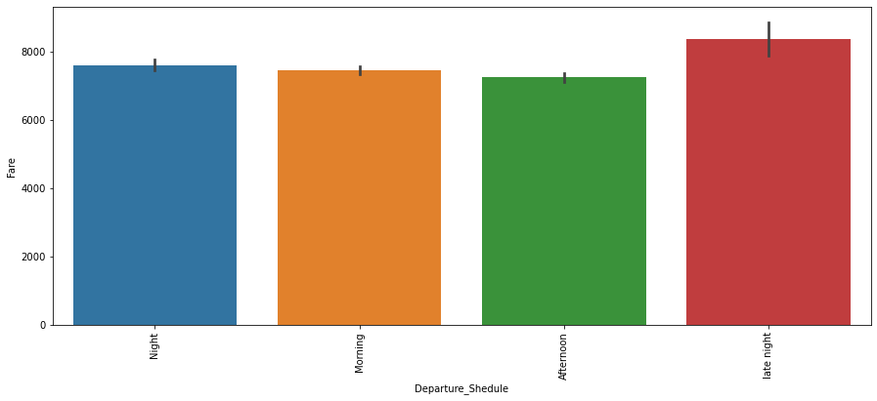
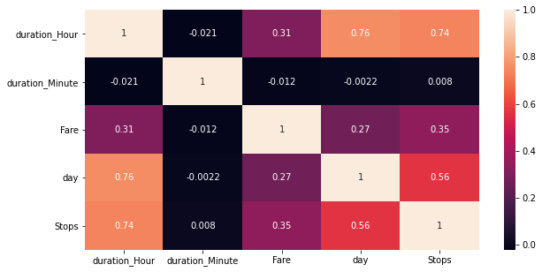

Slide 9
-:Future Work:-
1.More routes can be added and the same analysis can be expanded to major airports and travel routes in India.
2.The analysis can be done by increasing the data points and increasing the historical data used. That will train the model better accuracy and more savings.
3.More rules can be added in the rule based learning based on our understand of the industry, also incorporating the offer periods given by the airlines.
4.Developing a more user friendly interface for various routes giving more flexibility to the users.

Slide 10
-:CONCLUSION:-
From the data collected and through exploratory data analysis, we can determine the following:
The trend of flight prices vary over various months and across the holiday.
The airfare varies depending on the time of departure, making timeslot used in analysis an important parameter.
Airfare varies according to the day of the week of travel. It is higher for weekends and Monday and slightly lower for the other days.
There are a few times when an offer is run by an airline because of which the prices drop suddenly. These are difficult to incorporate in our mathematical models, and hence lead to error.
Along the Mumbai-Delhi route, we find that the price of flights increases or remains constant as the days to departure decreases. This is because of the high frequency of the flights, high demand and also could be due to heavy competition.

